Slide 1
Network Flow Models
Introduction

Slide 2
Today
Introduction to Network Flow
Network example
Minimum Cost Flow Problem
Transportation Problem
Transshipment Problem
Assignment Problem
Maximum Flow Problem
Shortest path Problem

Slide 3
Introduction

Slide 4
Example Network Flow

Slide 5
Example Network Flow

Slide 6
Minimum Cost Flow Problem (MCFP)

Slide 7
Special Network Model Transportation Model

Slide 8
Transportation Model

Slide 9
Transportation Model Example

Slide 10
Transportation Graphical Model

Slide 11
Transportation LP Model Example

Slide 12
Transshipment Model

Slide 13
Transshipment Model
In a Transshipment Problem flows can occur both out of and into the
same node in three ways:
1. a net creator of goods (a supply point).
- Flow balance equation will have a negative right hand
side (RHS) value.
2. a net consumer of goods, (a demand point).
- Flow balance equation will have a positive RHS value.
3. a pure transshipment point.
- Flow balance equation will have a zero RHS value.

Slide 14
The Transshipment Model
Characteristics
It is an extension of the transportation model.
Intermediate transshipment points are added between the sources and destinations.
Items may be transported from:
Sources through transshipment points to destinations
One source to another
One transshipment point to another
One destination to another
Directly from sources to to destinations
Some combination of these

Slide 15
Transshipment Model Example
Extension of the transportation model in which intermediate transshipment points are added between sources and destinations. An example of a transshipment point is a distribution center or warehouse located between plants and stores
Data:

Slide 16
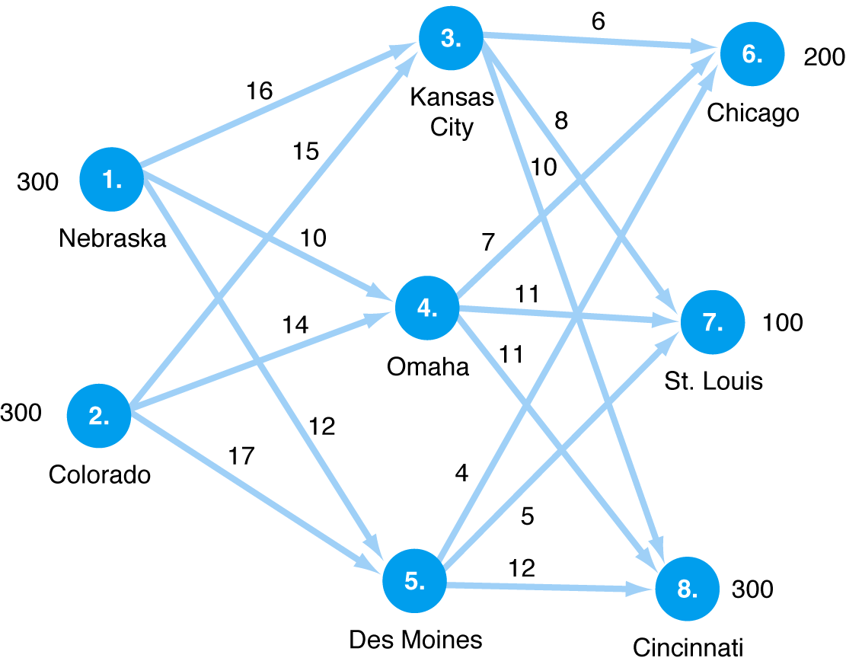
Transshipment Model Example

Slide 17
Transshipment Model Example 2
Model Formulation
Minimize Z = $16x₁₃ + 10x₁₄ + 12x₁₅ + 15x₂₃ + 14x₂₄ + 17x₂₅ + 6x₃₆ + 8x₃₇ + 10x₃₈ + 7x₄₆ + 11x₄₇ + 11x₄₈ + 4x₅₆ + 5x₅₇ + x₅₈
subject to:
x₁₃ + x₁₄ + x₁₅ = 300
x₂₃+ x₂₄ + x₂₅ = 300
x₃₆ + x₄₆ + x₅₆ = 200
x₃₇+ x₄₇ + x₅₇ = 100
x₃₈ + x₄₈ + x₅₈ = 300
x₁₃ + x₂₃ - x₃₆ - x₃₇ - x₃₈ = 0
x₁₄ + x₂₄ - x₄₆ - x₄₇ - x₄₈ = 0
x₁₅ + x₂₅ - x₅₆ - x₅₇ - x₅₈ = 0
x_{ij} ≥ 0

Slide 18
Special Network Model Assignment Problem Model

Slide 19
Assignment LP Model

Slide 20
Maximum Flow Problem LP Model

Slide 21
Max Flow Problem (Second Formulation)

Slide 22
Shortest Path Problem LP Model

Slide 23
Shortest Path Problem LP Model

Slide 24
Shortest Path Problem

Slide 25
T

Slide 26
SOLVING THE TRANSPORTATION PROBLEM
The transportation problem was one of the first special structures of linear programming for which an efficient special-purpose algorithm was developed.
In fact, special-purpose algorithms have been developed for all of the network structures presented in last lecture

Slide 27
Transportation Model

Slide 28
SOLVING THE TRANSPORTATION PROBLEM
1. obtaining an initial solution;
2. checking an optimality criterion that indicates whether or not a termination condition has been met (i.e., in the simplex algorithm, whether the problem is infeasible, the objective is unbounded over the feasible region, or an optimal solution has been found);
3. developing a procedure to improve the current solution if a termination condition has not been met.

Slide 29
SOLVING THE TRANSPORTATION PROBLEM
The transportation problem is a special network problem.
The equations are summarized very nicely by a tabular representation like that in Tableau E8.4.

Slide 30
SOLVING THE TRANSPORTATION PROBLEM
Initial Solutions
In order to apply the simplex method to the transportation problem, we must first determine a basic feasible solution.
Since there are (m + n) equations in the constraint set of the transportation problem, one might conclude that, in a nondegenerate situation, a basic solution will have (m + n) strictly positive variables

Slide 31
SOLVING THE TRANSPORTATION PROBLEM
In the transportation method one of the equations in the constraint set is redundant. In fact, any one of these equations can be eliminated without changing the conditions represented by the original constraints.
Thus, the constraint set is composed of (m + n − 1) independent equations, and a corresponding nondegenerate basic solution will have exactly (m + n − 1) basic variables.

Slide 32
SOLVING THE TRANSPORTATION PROBLEM
Initial Solutions: Northwest Corner Method
it starts with the upper leftmost corner (the northwest corner) and assigns the maximum possible flow allocation to that cell. Then it moves to the right, if there is any remaining supply in the first row, or to the next lower cell, if there is any remaining demand in the first column, and assigns the maximum possible flow allocation to that cell. The procedure repeats itself until one reaches the lowest right corner, at which point we have exhausted all the supply and satisfied all the demand.

Slide 33
SOLVING THE TRANSPORTATION PROBLEM
Initial Solutions: Northwest Corner Method

Slide 34
SOLVING THE TRANSPORTATION PROBLEM
Initial Solutions-2: Minimum matrix Method

Slide 35
SOLVING THE TRANSPORTATION PROBLEM
Initial Solutions-3: Vogel Method

Slide 36
SOLVING THE TRANSPORTATION PROBLEM
Initial Solutions-3: Vogel Method

Slide 37
SOLVING THE TRANSPORTATION PROBLEM
Initial Solutions-3: Vogel Method

Slide 38
SOLVING THE TRANSPORTATION PROBLEM
Initial Solutions-3: Vogel Method

Slide 39
SOLVING THE TRANSPORTATION PROBLEM

Slide 40
SOLVING THE TRANSPORTATION PROBLEM

Slide 41
SOLVING THE TRANSPORTATION PROBLEM
then it is optimal if there exist shadow prices (or simplex multipliers) ui associated with the origins and v j
associated with the destinations, satisfying
The simplex method selects multipliers so that the second condition holds for all basic variables, even if some basic variable xi j = 0 due to degeneracy.

Slide 42
SOLVING THE TRANSPORTATION PROBLEM
The algorithm will proceed as follows:
after a basic feasible solution has been found (possibly by applying the northwest-corner method or the minimum matrix method), we choose simplex multipliers ui and vj (i = 1, 2, . . . ,m; j = 1, 2, . . . , n) that satisfy:
for basic variables.

Slide 43
SOLVING THE TRANSPORTATION PROBLEM
With these values for the simplex multipliers, we compute the corresponding values of the reduced costs for all nonbasic variable using:
If every non basic reduce costs is nonnegative, then the optimal solution has been found; otherwise: we attempt to improve the current solution by increasing as much as possible the variable that corresponds to the most negative (since this is a minimization problem) reduced cost.

Slide 44
SOLVING THE TRANSPORTATION PROBLEM
First, let us indicate the mechanics of determining the simplex multipliers associated with a particular basis.
The optimality conditions consist of (m + n − 1) equations in (m + n) unknowns. However, any one of the simplex multipliers can be given an arbitrary value since, as we have seen, any one of the (m + n) equations of the transportation problem can be considered redundant.

Slide 45
SOLVING THE TRANSPORTATION PROBLEM
If every cij is nonnegative, then the optimal solution has been found; otherwise:
we attempt to improve the current solution by increasing as much as possible the variable that corresponds to the most negative (since this is a minimization problem) reduced cost.

Slide 46
Improving the Basic Solution
As we indicated, every basic variable has associated with it a value of ci j = 0.
If the current basic solution is not optimal, then there exists at least one nonbasic variable xij at value zero with cij bar negative. Let us select,
among all those variables, the one with the most negative.
Thus, we would like to increase the corresponding value of xst as much as possible, and adjust the values of the other basic variables to compensate for that increase.

Slide 47
SOLVING THE TRANSPORTATION PROBLEM
In our illustration, cst = c13 = −2, so we want to introduce x13 into the basis.
Adding the arc 1–3 to the spanning tree corresponding to the current basis creates a unique loop O1–D3–O2–D1–O1 where O and D refer to origin and destination, respectively.

Slide 48
SOLVING THE TRANSPORTATION PROBLEM
The limit to which can be increased corresponds to the smallest value of a flow on this loop from which must be subtracted.
In this example, may be increased to 15, corresponding to x11 being reduced to zero and therefore dropping out of the basis. The basis has x13 replacing x11, and the corresponding spanning tree has arc 1–3 replacing arc 1–1 in Fig. 8.12.

Slide 49
SOLVING THE TRANSPORTATION PROBLEM

Slide 50
SOLVING THE TRANSPORTATION PROBLEM
After increasing to 15, the resulting basic solution is given in Tableau 7 (ignoring ).

Slide 51
SOLVING THE TRANSPORTATION PROBLEM
the new multipliers and reduced costs in Tableau 8

Slide 52
SOLVING THE TRANSPORTATION PROBLEM

Slide 53
SOLVING THE TRANSPORTATION PROBLEM
ADDITIONAL TRANSPORTATION CONSIDERATIONS
In this case, we create an artificial destination j = n + 1, with corresponding ‘‘requirement’’ bn+1 = d,
and make the corresponding cost coefficients to this destination equal to zero, that is, ci,n+1 = 0 for
i = 1, 2, . . . ,m.
The variable xi,n+1 in the optimal solution will show how the excess availability is distributed
among the sources

Slide 54
SOLVING THE TRANSPORTATION PROBLEM
ADDITIONAL TRANSPORTATION CONSIDERATIONS
In this case, we create an artificial origin i = m+1, with corresponding ‘‘availability’’ am+1 = d, and assign zero cost coefficients to this destination, that is, cm+1, j = 0 for j = 1, 2, . . . , n.
The optimal value for the variable xm+1, j will show how the unsatisfied requirements are allocated among the destinations.

Slide 55
SOLVING THE TRANSPORTATION PROBLEM
Prohibited Routes
If it is impossible to ship any goods from source i to destination j , we assign a very high cost to the corresponding variable xij , that is, ci j = M, where M is a very large number, and use the procedure previously discussed.
If these prohibited routes cannot be eliminated from the optimal solution then the problem is infeasible.

Slide 56
SOLVING THE TRANSPORTATION PROBLEM
Degeneracy
Degeneracy can occur on two different occasions during the computational process described in the previous section.
First, during the computation of the initial solution of the transportation problem, we can simultaneously eliminate a row and a column at an intermediate step. This situation gives rise to a basic solution with less than (m + n − 1) strictly positive variables.

Slide 57
SOLVING THE TRANSPORTATION PROBLEM
As an example, let us apply the northwest-corner rule to the case in Tableau 11.
We thus make x13 = 0, and treat it as a basic variable in the rest of the computation.

Slide 58
SOLVING THE TRANSPORTATION PROBLEM
A second situation where degeneracy arises is while improving a current basic solution. A tie might be found when computing the new value to be given to the entering basic variable, xst = .
In this case, more than one of the old basic variables will take the value zero simultaneously, creating a new basic solution with less than (m + n − 1) strictly positive values.
Once again, the problem is overcome by choosing the variable to leave the basis arbitrarily from among the basic variables reaching zero.

